Slide 1
Location…
Location, location
marketing analytics
Jan 24, 2017

Slide 2
Overview
Marketing analytics team focused on establishing initial segmentation strategy in Q4 2016. Decided on modified RFM approach and are currently in the process of implementing in the new Marketing Database.
Profile | Members | Active Members | Conversion | Rev/Mem | Res/Mem | Rev/Act Mem | Res/Act Mem
Power User | 22,750 | 15,755 | 69.3% | $ 95.56 | 1.93 | $ 137.98 | 2.79
Strong | 50,167 | 21,055 | 42.0% | $ 34.78 | 0.78 | $ 82.86 | 1.86
Standard+ | 103,806 | 27,677 | 26.7% | $ 16.53 | 0.41 | $ 62.00 | 1.55
Standard- | 114,499 | 13,297 | 11.6% | $ 6.99 | 0.15 | $ 60.20 | 1.29
Vulnerable | 59,257 | 3,868 | 6.5% | $ 3.77 | 0.08 | $ 57.76 | 1.20
Low Activity | 451,995 | 9,982 | 2.2% | $ 1.82 | 0.03 | $ 82.31 | 1.34

Slide 3
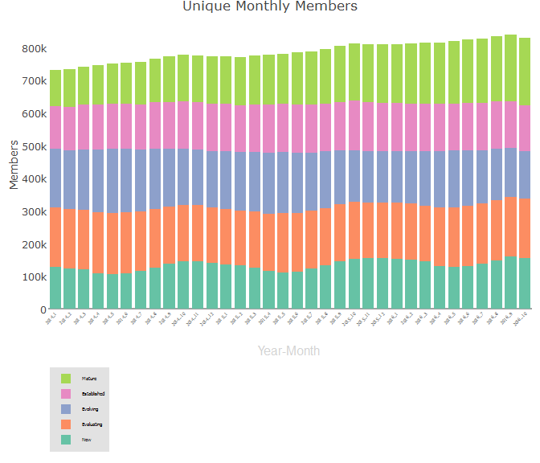
Overview
Additionally, created Tenure buckets as a secondary segmentation:
0-6 months (New)
6-18 months (Evaluating)
18-36 months (Evolving)
36-60 months (Established)
60+ months (Mature)

Slide 4
Overview
RFM and Tenure are helpful in understanding the composition and activity levels of the membership base.
Not easy to activate against from a campaign/marketing perspective.

Slide 5
Location segmentation
Should be complementary to RFM not redundant
RFM is very heavily focused on usage (Number of res, cadence, etc.)
Try to remove as much correlation with # of reservations as possible

Slide 6
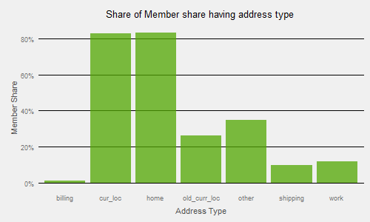
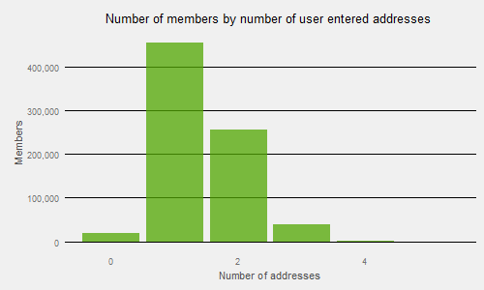
Location segmentation
Looking at the types of addresses* we have for members, pretty good coverage across the entire member base.
Address can be divided into two groups: User entered and inferred.
Focus only on user-entered addresses
Calculate distance for each reservation to all addresses we have on file for member – use the minimum distance as our “distance to reservation”
For members with no user entered address – use median difference for zipfleet.
*currently no address/location from mobile.

Slide 7
Member distance to reservation (by zipfleet)
LOCATION_ZIPFLEET | my.deciles.10 | my.deciles.20 | my.deciles.30 | my.deciles.40 | my.deciles.50 | my.deciles.60 | my.deciles.70 | my.deciles.80 | my.deciles.90
atlanta_region | 0.07 | 0.12 | 0.19 | 0.31 | 0.44 | 0.74 | 1.23 | 2.92 | 10.89
austin_region | 0.07 | 0.15 | 0.23 | 0.35 | 0.51 | 0.65 | 0.90 | 2.05 | 979.55
baltimore_region | 0.05 | 0.10 | 0.14 | 0.18 | 0.24 | 0.33 | 0.50 | 0.86 | 2.41
boston_region | 0.06 | 0.10 | 0.15 | 0.21 | 0.28 | 0.40 | 0.66 | 1.43 | 3.47
chicago_region | 0.05 | 0.09 | 0.13 | 0.18 | 0.25 | 0.34 | 0.52 | 0.99 | 2.95
country_us_agencies | 0.07 | 0.12 | 0.19 | 0.25 | 0.33 | 0.45 | 0.63 | 0.93 | 2.45
country_us_airports | 0.19 | 1.13 | 4.37 | 25.12 | 388.24 | 611.26 | 836.53 | 1,150.26 | 1,968.46
dallas_region | 0.04 | 0.09 | 0.12 | 0.18 | 0.31 | 0.56 | 0.93 | 1.23 | 2.94
dc_region | 0.05 | 0.10 | 0.15 | 0.21 | 0.29 | 0.44 | 0.76 | 1.67 | 4.76
denver_region | 0.07 | 0.12 | 0.20 | 0.36 | 0.67 | 1.53 | 11.45 | 920.92 | 1,509.78
detroit_region | 0.07 | 0.09 | 0.12 | 0.16 | 0.23 | 0.30 | 0.44 | 0.70 | 2.31
houston_region | 0.06 | 0.15 | 0.24 | 0.34 | 0.43 | 0.64 | 1.13 | 2.92 | 236.05
los_angeles_region | 0.10 | 0.17 | 0.24 | 0.34 | 0.48 | 0.66 | 1.30 | 5.14 | 341.12
miami_region | 0.05 | 0.10 | 0.18 | 0.25 | 0.39 | 0.57 | 1.18 | 21.35 | 1,088.40
milwaukee_region | 0.07 | 0.13 | 0.18 | 0.24 | 0.30 | 0.38 | 0.48 | 0.74 | 1.96
minneapolis_region | 0.02 | 0.04 | 0.07 | 0.15 | 0.22 | 0.35 | 0.60 | 1.06 | 11.44
ny_region | 0.07 | 0.12 | 0.17 | 0.23 | 0.31 | 0.42 | 0.61 | 1.11 | 2.96
philadelphia_region | 0.07 | 0.11 | 0.16 | 0.21 | 0.29 | 0.39 | 0.58 | 1.01 | 2.49
pittsburgh_region | 0.07 | 0.14 | 0.19 | 0.25 | 0.35 | 0.51 | 0.79 | 1.32 | 3.32
portland_region | 0.05 | 0.09 | 0.13 | 0.18 | 0.26 | 0.35 | 0.53 | 1.07 | 3.30
providence_region | 0.06 | 0.11 | 0.15 | 0.21 | 0.26 | 0.38 | 0.57 | 1.02 | 5.47
sacramento_region | 0.09 | 0.14 | 0.20 | 0.27 | 0.41 | 0.61 | 0.89 | 1.34 | 2.85
san_diego_region | 0.05 | 0.13 | 0.22 | 0.32 | 0.44 | 0.54 | 0.76 | 1.16 | 96.90
sanfrancisco_region | 0.06 | 0.10 | 0.14 | 0.19 | 0.25 | 0.36 | 0.58 | 1.23 | 5.29
seattle_region | 0.04 | 0.07 | 0.11 | 0.15 | 0.21 | 0.32 | 0.54 | 1.18 | 5.01
toronto_region | 0.05 | 0.10 | 0.15 | 0.21 | 0.29 | 0.43 | 0.73 | 1.36 | 3.52
vancouver_region | 0.05 | 0.10 | 0.14 | 0.21 | 0.30 | 0.45 | 0.73 | 1.42 | 4.15

Slide 8
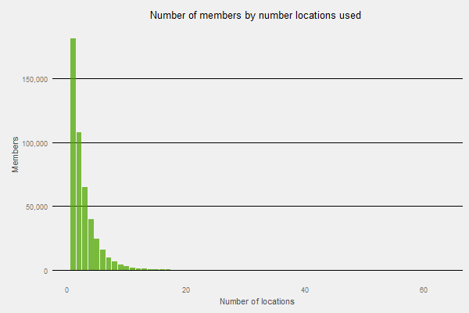
Location segmentation
Roughly 40% of Members have no reservations over the past 6 months.
Of those who made a reservation, around 40% used a single location (not surprising given the high number of single trip users)
Therefore 60% of driving members used multiple locations.

Slide 9
Location segmentation
Should be complementary to RFM not redundant
RFM is very heavily focused on usage (Number of res, cadence, etc.)
Try to remove as much correlation with # of reservations as possible
Two axis
Proximity: What percentage of a member’s reservations happened within the median distance for the relevant Zipfleet
Uniformity: What percentage of a member’s total reservations happened at their most frequented location

Slide 10
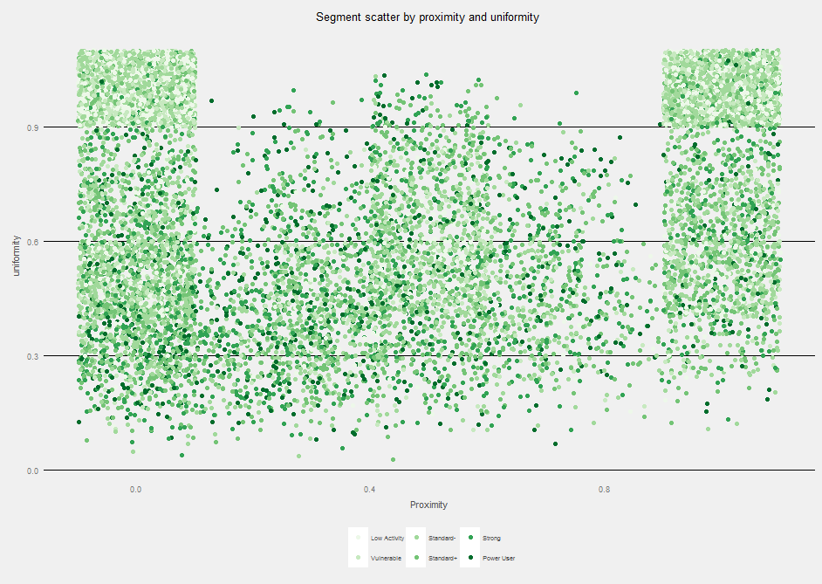
Location segmentation
Representative sample of members
Both axis are bound by 0 and 1
RFM are evenly and randomly disbursed
Divide and segment by quadrant:
Lower left: Traveler
Upper left: Intermittent
Upper right: Homebody
Lower right: Opportunists

Slide 11
Member location segmentation breakdown
LocationSegment | members | reservations | locations | Reservations/Member | Locations/Member | Quadrant
No Res | 367,534 | - | - | - | - | Don’t appear
Homebody* | 97,900 | 540,157 | 137,640 | 5.52 | 1.41 | Upper right
Traveler | 109,175 | 1,051,846 | 486,031 | 9.63 | 4.45 | Lower left
Intermittent | 92,484 | 381,420 | 123,916 | 4.12 | 1.34 | Upper left
Opportunists | 98,928 | 880,133 | 373,452 | 8.90 | 3.77 | Lower right
*Names are (definitely) subject to change
The current criteria is 34% line for Proximity; 67% for Uniformity
Nice stratification amongst our segments
Segment | No Res | Homebody | Travelers | Intermittent | Opportunists
Power User | 10 | 3,217 | 9,476 | 2,641 | 7,546
Strong | 92 | 7,579 | 19,110 | 5,566 | 15,556
Standard+ | 192 | 17,288 | 28,101 | 11,059 | 26,612
Standard- | 367 | 32,763 | 31,471 | 27,485 | 30,589
Vulnerable | 226 | 15,830 | 11,538 | 18,642 | 10,170
Low Activity | 366,647 | 21,223 | 9,479 | 27,091 | 8,455
As well as even distribution across RFM segments

Slide 12
Location segmentation
LOCATION_ID | res | members | min.dist | max.dist | mean.dist | med.dist | top.mem | leverage
95985 | 1035 | 300 | 0.00 | 3280.30 | 13.45 | 1.44 | 45 | 4.3%
17840226 | 1023 | 491 | 0.02 | 3279.84 | 62.66 | 0.50 | 18 | 1.8%
20280070 | 984 | 481 | 0.00 | 3407.52 | 72.29 | 2.10 | 26 | 2.6%
1068545765 | 928 | 371 | 0.00 | 2699.67 | 66.93 | 0.51 | 20 | 2.2%
475611970 | 862 | 297 | 0.03 | 2794.54 | 31.72 | 2.38 | 24 | 2.8%
96060 | 852 | 399 | 0.01 | 3274.31 | 69.36 | 2.47 | 31 | 3.6%
711159822 | 829 | 370 | 0.03 | 3285.48 | 52.36 | 1.76 | 38 | 4.6%
20691984 | 828 | 269 | 0.02 | 2642.10 | 75.07 | 0.29 | 49 | 5.9%
13933458 | 812 | 381 | 0.00 | 3282.36 | 51.29 | 0.49 | 28 | 3.4%
23384410 | 805 | 425 | 0.02 | 3275.73 | 106.90 | 1.69 | 33 | 4.1%
12574573 | 788 | 328 | 0.05 | 2697.65 | 83.60 | 0.92 | 26 | 3.3%
452346551 | 784 | 391 | 0.00 | 2700.47 | 153.74 | 1.05 | 30 | 3.8%
6917255 | 734 | 325 | 0.00 | 3278.39 | 140.27 | 0.80 | 52 | 7.1%
45859123 | 721 | 314 | 0.00 | 2698.75 | 71.92 | 0.61 | 27 | 3.7%
1327143404 | 714 | 315 | 0.00 | 4837.06 | 64.72 | 0.60 | 23 | 3.2%
1459632994 | 695 | 372 | 0.03 | 2701.87 | 52.22 | 1.89 | 26 | 3.7%
1791063726 | 679 | 342 | 0.00 | 3279.61 | 63.88 | 1.29 | 18 | 2.7%
6083193 | 671 | 372 | 0.04 | 5088.60 | 103.12 | 1.08 | 12 | 1.8%
80910470 | 666 | 221 | 0.00 | 2700.41 | 82.04 | 0.18 | 37 | 5.6%
As a complement to Member-based location data, we can also look at the same type of data by Pod
The table to the right is a summary of 4 weeks of activity by location. It shows total unique members, and how far on ‘average’ they were from a known location.

Slide 13
Location segmentation
We can focus in on a particular location and see the specifics by our Usage Profile segments:
Profile | members | reservations | dist.mean | my.deciles.10 | my.deciles.20 | my.deciles.30 | my.deciles.40 | my.deciles.50 | my.deciles.60 | my.deciles.70 | my.deciles.80 | my.deciles.90
Power User | 117 | 1196 | 0.58 | 0.13 | 0.13 | 0.18 | 0.24 | 0.32 | 0.45 | 0.64 | 0.76 | 1.00
Strong | 172 | 947 | 1.35 | 0.09 | 0.21 | 0.27 | 0.45 | 0.64 | 0.84 | 0.98 | 1.47 | 3.28
Standard+ | 203 | 762 | 2.87 | 0.08 | 0.15 | 0.20 | 0.24 | 0.32 | 0.62 | 0.79 | 1.43 | 3.59
Standard- | 180 | 428 | 1.24 | 0.18 | 0.25 | 0.34 | 0.43 | 0.52 | 0.78 | 0.88 | 1.92 | 3.92
Vulnerable | 74 | 142 | 14.21 | 0.21 | 0.25 | 0.27 | 0.42 | 0.64 | 0.85 | 1.45 | 1.95 | 3.38
Low Activity | 62 | 100 | 14.03 | 0.11 | 0.13 | 0.21 | 0.39 | 0.45 | 0.84 | 1.29 | 2.13 | 3.96
NA | 159 | 647 | 118.29 | 0.09 | 0.16 | 0.16 | 0.16 | 0.32 | 0.32 | 0.32 | 0.43 | 63.56
Location.Seg | members | reservations | dist.mean | my.deciles.10 | my.deciles.20 | my.deciles.30 | my.deciles.40 | my.deciles.50 | my.deciles.60 | my.deciles.70 | my.deciles.80 | my.deciles.90
Homebody | 67 | 426 | 0.40 | 0.09 | 0.15 | 0.17 | 0.18 | 0.20 | 0.22 | 0.25 | 0.35 | 0.98
Intermittent | 110 | 418 | 1.33 | 0.11 | 0.34 | 0.44 | 0.49 | 0.63 | 0.75 | 0.84 | 3.06 | 3.50
Opportunists | 155 | 424 | 0.74 | 0.08 | 0.12 | 0.20 | 0.25 | 0.41 | 0.56 | 0.74 | 1.10 | 1.91
Traveler | 476 | 2307 | 3.01 | 0.13 | 0.15 | 0.24 | 0.32 | 0.48 | 0.68 | 0.84 | 1.47 | 3.04
NA | 159 | 647 | 118.29 | 0.09 | 0.16 | 0.16 | 0.16 | 0.32 | 0.32 | 0.32 | 0.43 | 63.56

Slide 14
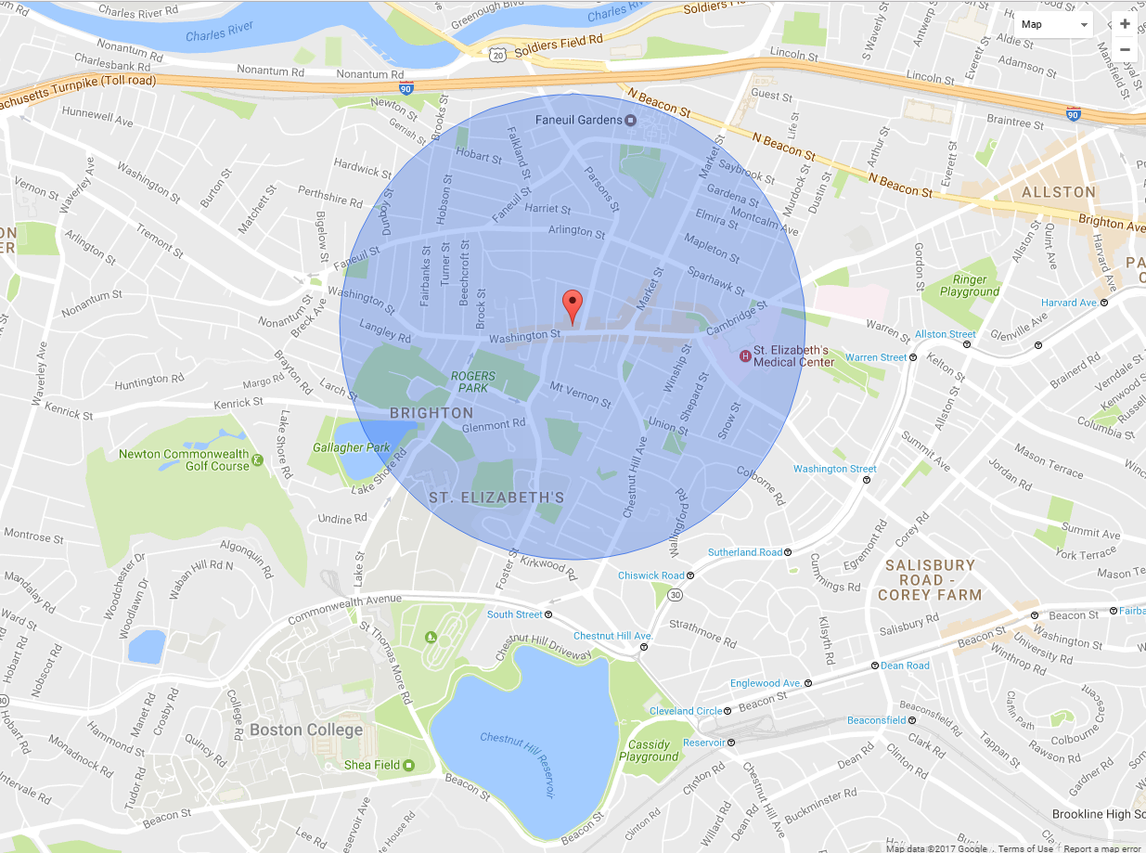
Users in the median distance of location 95985
MEMBER_ID | LAT | LONG | LocationSegment | Profile | dist.to.location
100362853 | 42.3504 | -71.1566 | Intermittent | Low Activity | 0.08
1005403755 | 42.34899 | -71.15369 | Opportunists | Vulnerable | 0.13
1006725495 | 42.3501 | -71.1564 | Intermittent | Vulnerable | 0.06
100831188 | 42.35101 | -71.16532 | Homebody | Standard+ | 0.48
1016226637 | 42.34406 | -71.1525 | Opportunists | Vulnerable | 0.41
1019247927 | 42.34193 | -71.15508 | Traveler | Low Activity | 0.51
1019535310 | 42.3485 | -71.15794 | Intermittent | Low Activity | 0.11
1020811828 | 42.35563 | -71.15865 | Intermittent | Vulnerable | 0.45
1024798250 | 42.34804 | -71.15553 | Traveler | Standard- | 0.09
1026769297 | 42.35107 | -71.15083 | Traveler | Standard- | 0.30
1026977984 | 42.35008 | -71.1628 | Opportunists | Standard+ | 0.34
1039663263 | 42.3499 | -71.15598 | Homebody | Standard+ | 0.04
104318029 | 42.35009 | -71.14943 | Traveler | Standard+ | 0.35
104318029 | 42.35004 | -71.14942 | Traveler | Standard+ | 0.35
1045276046 | 42.3501 | -71.1564 | Traveler | Standard+ | 0.06
105051063 | 42.34984 | -71.1621 | Opportunists | Low Activity | 0.31
1051254444 | 42.3501 | -71.1564 | Intermittent | Standard+ | 0.06
1054416821 | 42.34259 | -71.15122 | Homebody | Vulnerable | 0.53
1060507155 | 42.35022 | -71.15397 | Traveler | Power User | 0.13
1061026184 | 42.34878 | -71.15507 | Intermittent | Low Activity | 0.07
106237700 | 42.34971 | -71.14825 | Traveler | Standard- | 0.41
1066322436 | 42.35127 | -71.15214 | Opportunists | Low Activity | 0.25
1068136533 | 42.34151 | -71.15477 | Traveler | Standard- | 0.54

Slide 15
Homebody Power User in the median distance of location 95985
MEMBER_ID | LAT | LONG | LocationSegment | Profile | dist.to.location
11204990 | 42.34923 | -71.15299 | Homebody | Power User | 0.16
1722693612 | 42.35366 | -71.15967 | Homebody | Power User | 0.35
1964204224 | 42.35507 | -71.15094 | Homebody | Power User | 0.48
329872888 | 42.35141 | -71.14807 | Homebody | Power User | 0.44
329872888 | 42.35119 | -71.14797 | Homebody | Power User | 0.44
329872888 | 42.34998 | -71.1524 | Homebody | Power User | 0.20
544729035 | 42.34833 | -71.14993 | Homebody | Power User | 0.33
861111157 | 42.34938 | -71.16186 | Homebody | Power User | 0.29

Slide 16
Next steps
Currently being scoped for incorporation into Marketing DB
Formalize Location based statistics
Individualized Distance elasticity curves
Forecast weekly demand by location based on member probability to reserve by Maximum Likelihood Estimates of distance to travel

